Slide 1
Precision Instruments
Aerospace Manufacturing Core Study Guide
“AMCSG-206”
Tools & Processes

Slide 2
Intro to Precision Instruments

Slide 3
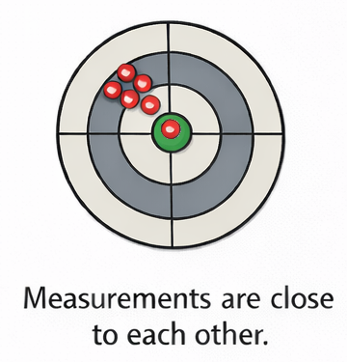
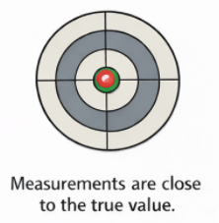
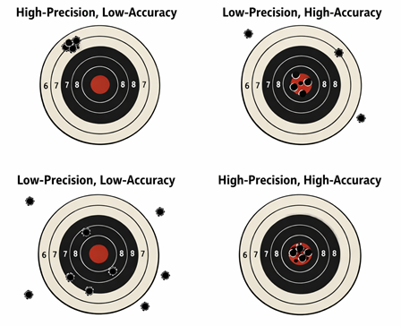

Fundamental Concepts
Text from Google AI
Precision = Repeatability - How consistent is tool.
Accuracy = Trueness - How close Measured value is to Real value.
“Accuracy vs. Precision” - Must be both in aircraft manufacturing
Precision
Accuracy
Accuracy vs. Precision
ChatGPT / Matt Pierce, 2026
ChatGPT / Matt Pierce, 2026
ChatGPT / Matt Pierce, 2026
Notes:
Google AI: “write a pictorial guide to the general use of precision instruments in aerospace manufacturing. Define "Precision and Accuracy". Define "Environment" (especially temperature expanding metal). Define "cleanliness" (dirty parts hard to measure). Define "accuracy" and "calibration" and use of "masters". Define "measurement tool discrimination". Define "resolution". Define how to take a measurement from the "reference point" to the "measurement point" to get the "measurement distance“”
ChatGPT: “make a diagram showing the difference between (1) Precision (repeatability), (2) Accuracy (Trueness), and (3) Accuracy vs. Precision. Context is aircraft manufacturing precision tools like a caliper or a micrometer.“ + Remove the picture of a caliper. Remove the picture of a micrometer. Make the bullseye a green dot everywhere + In picture #2, make the red dot appear dead center in the green dot. Make the title for picture #3 the same red color as pictures #1 an #2. + Remove the red titles. Make the red dot in picture #2 same size as red dots in picture #1.

Slide 4
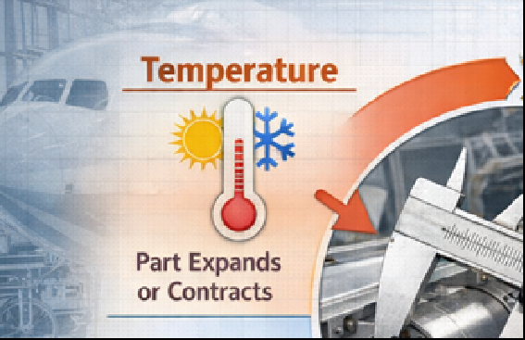
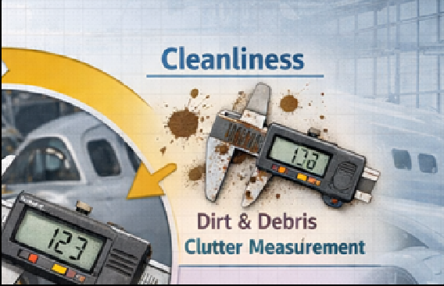
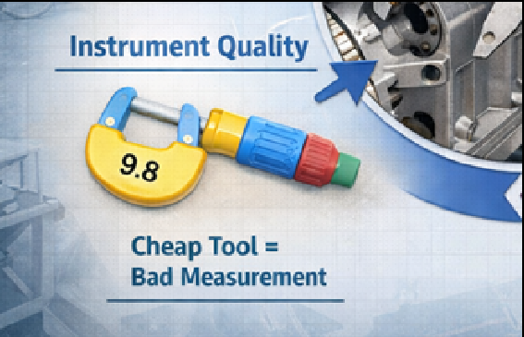
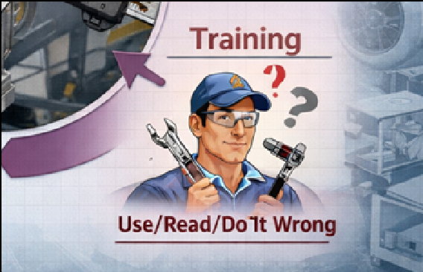
Factors Influencing Precision & Accuracy
Text from ChatGPT
Temperature:
Metal parts expand or contract
Cleanliness:
Dirty part or gauge = bad measure
Use solvents, wipe clean
Instrument Quality:
Cheap tool = bad measure
Training & Usage:
Use it wrong, Read it wrong, Do it wrong = bad measure
ChatGPT / Matt Pierce, 2026
Notes:
ChatGPT: Make a diagram showing 4 factors that influence precision and accuracy of aircraft manufacturing precision tools: 1. Temperature (part expands or contracts) 2. Cleanliness (dirt and debris clutter measurement) 3. Instrument Quality (cheap tool = bad measurement) 4. Training (use it wrong or read it wrong = bad measurement) + Remove the blue title.
+ Change title from "Use It Wrong or Read it Wrong" to "Use/Read/Do It Wrong".
+ Change tool in picture "Instrument Quality" to a really cheap "Micrometer" that is the cheapest model out there with few options and poor quality.
+ Make the micrometer in the lower left picture made out of plastic and like a kids toy.

Slide 5
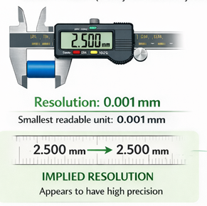
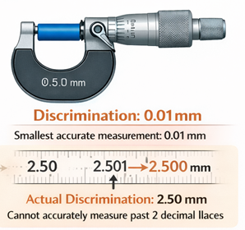
Resolution vs. Discrimination
Text from ChatGPT
Resolution = Smallest unit of measure readable from instrument
Discrimination = Smallest value instrument can accurately measure
Implied Resolution
Fails Verification
ChatGPT / Matt Pierce, 2026
ChatGPT / Matt Pierce, 2026
Notes:
ChatGPT: make a diagram using a precision instrument like a caliper or micrometer that shows the difference between "resolution" (smallest readable unit of measure) and "discrimination" (smallest value instrument can measure) + redo the diagram using same instruments, but instead emphasize that an instrument may imply it has great resolution, but its actual discrimination (ability to accurately measure) is less than the resolution. + show the micrometer instrument on the right side measuring the same part as the caliper on the left side. color the part being measured by each tool in bright blue.

Slide 6
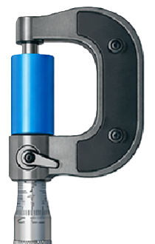
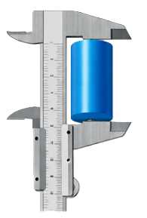
Measurement Definitions
Text from ChatGPT
Measurements generally have three parts:
Reference Point (from static / non-moving part of instrument)
Measurement Point (from moving part of instrument)
Measurement Distance (the difference)
Reference Point
ChatGPT / Matt Pierce, 2026
Measurement Distance
ChatGPT / Matt Pierce, 2026
Measurement Point
Notes:
ChatGPT: make diagram comparing a micrometer measuring a bright blue cylinder on the right, and a caliper measuring the same blue cylinder on the left.

Slide 7
Types of Precision Instruments

Slide 8
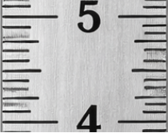


What is a “Rule”?
Measures: Length
Rule Body
Measurement Scale
Discrimination Value
ChatGPT / Matt Pierce, 2026
ChatGPT / Matt Pierce, 2026
Graduation Lines
Notes:
ChatGPT: make a diagram of a metal rule (not a ruler). make it standing vertical. make the digits increment from 1" to 12" in one inch increments.

Slide 9
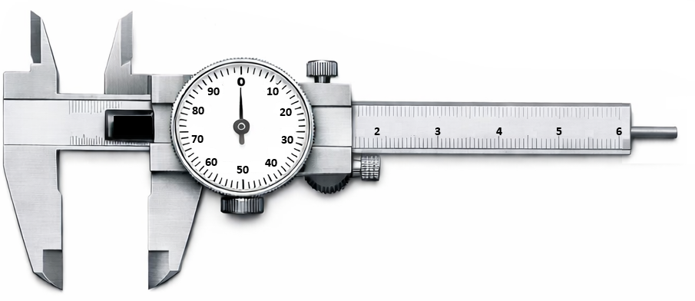
What is a “Caliper”?
Measures:
- Thickness
- Diameter
- Depth
- Other…
Stationary Body
Moveable Body
Internal Jaws
Dial Indicator
Depth Blade
ChatGPT / Matt Pierce, 2026
Thumbwheel
External Jaws
Dial Lock
Notes:
ChatGPT: make a single diagram showing the parts of a dial caliper + Use picture #3. Remove metrics measurements everywhere. + Remove all labels and arrows. + Add a blowup image showing the value measured, including the vernier scale, the main scale and how the reading is taken + make the yellow dial background all white + make the dial indicator go from 0 to 100 + change the dial indicator numeric values to the following in clockwise order starting from 0 at the top: 10, 20, 30, 40, 50, 60, 70, 80, 90. Use only 10 numbers (not 11 as is currently shown)

Slide 10
How to Use a Caliper
Text from Google AI
Zero Out Instrument - Close jaws completely; needle points to "0". If not: loosen dial lock, rotate dial face to zero, re-tighten dial lock.
Read Main Beam (Inches) - Look at last numbered digit sliding jaw passed. This is whole inch measurement.
Read Main Beam (Tenths) - Count smaller hash marks passed after whole inch. Each hash = 0.100” (1/10th”)
Read Dial (Thousandths) - Read number on dial face. Each mark is 0.001” (1/1000th”)
Calculate Total - Add the values together (Inches + Tenths + Dial). For example, if the beams shows 1.3” and the dial reads 56, the measurement is 1.3 + 0.056 = 1.356”
Notes:
Google AI: “how to read a dial caliper”

Slide 11
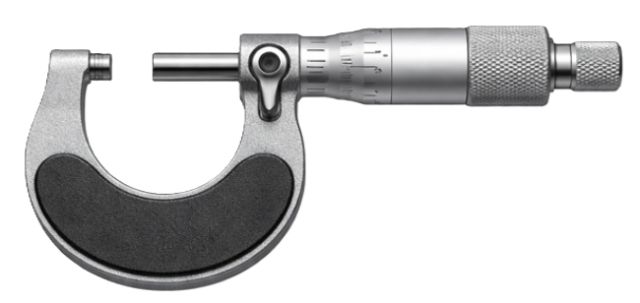
What is a “Micrometer”?
Measures:
- Small Thickness
- Small Diameter
- Small Depth
- Small Other…
Anvil
Spindle
Sleeve
Thimble
Ratchet Stop
ChatGPT / Matt Pierce, 2026
Lock
Frame
Notes:
ChatGPT: make a single diagram showing the parts of a micrometer + Remove all labels, show only the micrometer for picture #2

Slide 12
How to Use a Micrometer
List from Google AI
Zero Out Instrument - Close spindle completely using ratchet stop to avoid over-tightening; if sleeve not align to 0 use supplied spanner wrench to reset to 0
Read Main Sleeve (Tenths) - Identify last visible numbered digit. This is 0.100” (1/10” … so a “3” would be 3/10” or 0.300”).
Read Main Sleeve (25-Thousandths) - Count smaller vertical marks past the number. Each hash = 0.025” (25/1000th”)
Read Thimble (Thousandths) - Read number on thimble aligning with horizontal index line of sleeve. Each mark is 0.001” (1/1000th”)
Calculate Total - Add the values together. For example, Sleeve shows “2” (0.200”) + 3 small lines (0.075”) + Thimble shows “12” (0.012”) Thus Total = 0.200 + 0.075 + 0.012 = 0.287”
Notes:
Google AI: “how to read a micrometer”
Google AI: “how to zero out a micrometer”

Slide 13
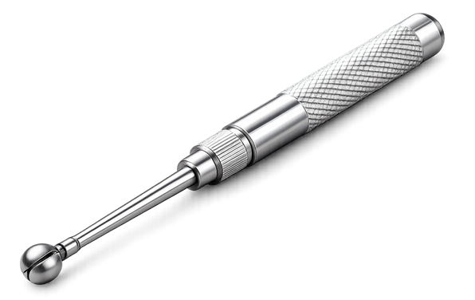
What is a “Split Ball Gauge”?
Measures:
- Small Hole Diameter
- Slot Width - Recess Depth
Handle
Thimble
ChatGPT / Matt Pierce, 2026
Split Ball
Notes:
ChatGPT: Make a photo of a split ball gauge used to measure small hole diameter + remove all the backdrop

Slide 14
How to Use a Split Ball Gauge
Text from Google AI
Select & Prepare - Choose correct size gauge for hole. Clean it and hole.
Insert & Adjust - Insert contracted gauge into hole. Rotate Thimble to expand ball until it makes light contact with hole walls.
Locate Max Dia (Rocking) - Gently rock gauge back-and-forth, side-by-side, up-and-down the hole to locate the maximum diameter
Lock and Remove - If available, lock the gauge. Remove gauge.
Measure - Use a micrometer to measure the split ball head
Notes:
Google AI: “how to read a micrometer”
Google AI: “how to zero out a micrometer”

Slide 15
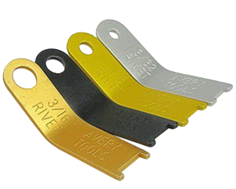
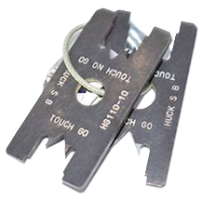

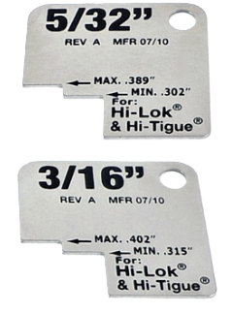
Examples of Go/NoGo Gauges
Plug Gauge
Rivet Head Gauges
Swage Style Rivet Gauges
Pin Protrusion Gauges
ChatGPT / Matt Pierce, 2026
ChatGPT / Matt Pierce, 2026
ChatGPT / Matt Pierce, 2026
ChatGPT / Matt Pierce, 2026
Notes:
ChatGPT: show me a picture of Go/NoGo Plug Gauge. Heavily manually edited.
ChatGPT: show me a picture of Rivet Inspection Guage. Took two pictures, one for rivet head gauge set, other for swage style rivet gauges
ChatGPT: show me a picture of a pin protrusion gauge

Slide 16
Q&A

Slide 17
Practice Q&A’s (Q1-Q8)
Q5: How do you fix a dirty part or gauge so that precision and accuracy are optimal?
A: Wipe clean with a solvent
Q6: How can you avoid using, reading, or doing precision measurements wrong?
A: Proper training and practice
Q7: Name of the smallest visible unit of measure readable on the precision instrument?
A: Resolution
Q8: Name of the smallest unit of measure the precision instrument can accurately measure, regardless of what is readable?
A: Discrimination
Q1: Name for repeatability; how consistently a tool measures?
A: Precision
Q2: Name for how close the measured value is to the real value?
A: Accuracy
Q3: Y/N: Can a precision measurement tool be accurate, but not precise?
A: Yes. Even a broken analog watch is accurate twice a day (but not at all precise)
Q4: What factor makes a metal part expand or contract?
A: Temperature

Slide 18
Practice Q&A’s (Q9-Q16)
Q13: What is the difference between a Rule and a Ruler?
A: Rule edge starts at 0". Ruler has about 1/16" gap before the 0" mark starts (for kids to wear away)
Q14: Name of precision instrument that uses jaws to measure up to 6" in distance, with a blade to measure depth too?
A: Caliper
Q15: What is the first step you should do every time you take a caliper measurement to ensure accuracy?
A: Zero-Out Caliper
Q16: Name of precision instrument that uses an anvil and spindle to measure distance?
A: Micrometer
Q9: Name of tip of non-moving part of precision instrument from which measurement starts?
A: Reference Point
Q10: Name of tip of moving point on a precision instrument where measurement ends?
A: Measurement Point
Q11: Name of the distance between the reference and measurement points?
A: Measurement Distance
Q12: Name of a precision instrument used to draw straight lines and measure distance typically up to 12"?
A: Rule

Slide 19
Practice Q&A’s (Q17-Q)
Q17: Name of precision instrument that goes inside a hole and captures the diameter to be measured by a micrometer?
A: Split Ball Gauge
Q18: Another name for fixed (non-variable) precision instruments?
A: Go/NoGo Gauges

Slide 20
Thank You
Matt Pierce - mpierce710006@gmail.com - linkedin.com/in/mpiercead576/
https://github.com/DataResearchLabs/study_guide_intro_aerospace_mfg

